Slide 1










Social Media Analytics Product Preference Networks MSBA, 7th Feb, 2022
Dr. Anitesh Barua
David Bruton Jr. Centennial Chair Professor of Business
Distinguished Fellow, INFORMS Information Systems Society
University of Texas Distinguished Teaching Professor
Associate Director, Center for Research in e-Commerce
McCombs School of Business, University of Texas at Austin
Email: aniteshb@gmail.com

Slide 2
SMA Project: Example #1
Your Customers Help Each Others or Do They? An Analysis of an Enterprise-to-Enterprise Forum
The Mantra: “Let customers help each other”
Cisco and Dell implemented successfully
Not a new idea, but difficult to succeed with
Right kind of (typically social) incentives
Enterprise to Enterprise (E2E) Community of Texas Instruments (TI)
Tools and software products
Both customers and TI employees
To what extent are customers helping each other?
What is the role of TI employees?
Is TI recognizing the right people?
*MSBA project by Megan, Lydia, Anusha, Diana & Tianjiao

Slide 3
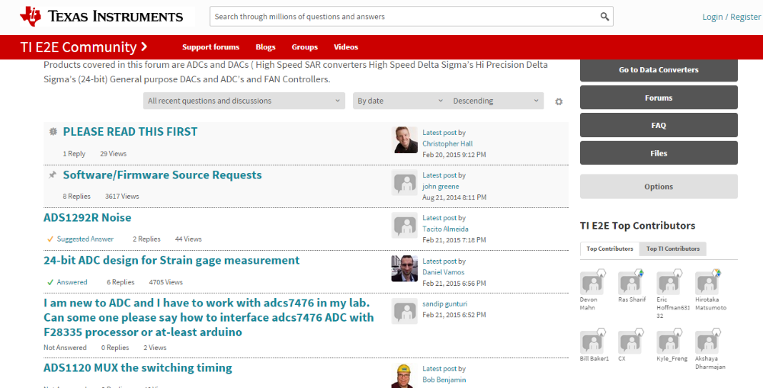
The Forum
http://e2e.ti.com/support/data_converters/precision_data_converters/f/73
Python crawler, 24682 messages from one forum
Variables: Time, poster, level, points, member type, response to, content (text)
What kind of analysis can answer the questions?

Slide 4
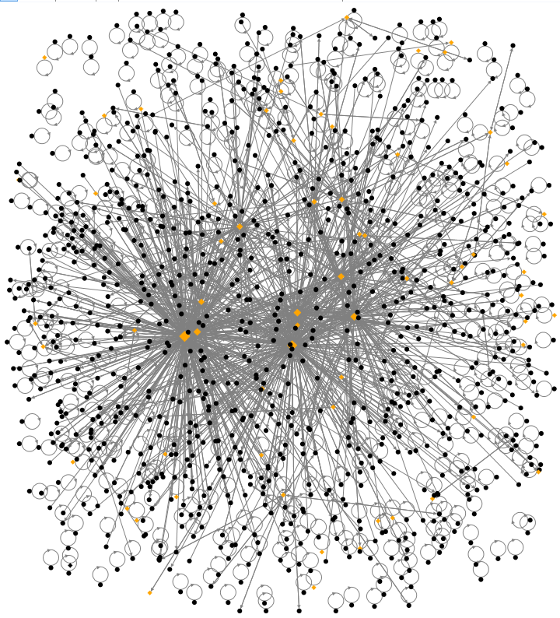
TI Forum Network
Includes all participants who have posted ≥ three times.
TI employees (Orange color) are central
Many self loops
Top 20 (by degree) are all TI employees

Slide 5
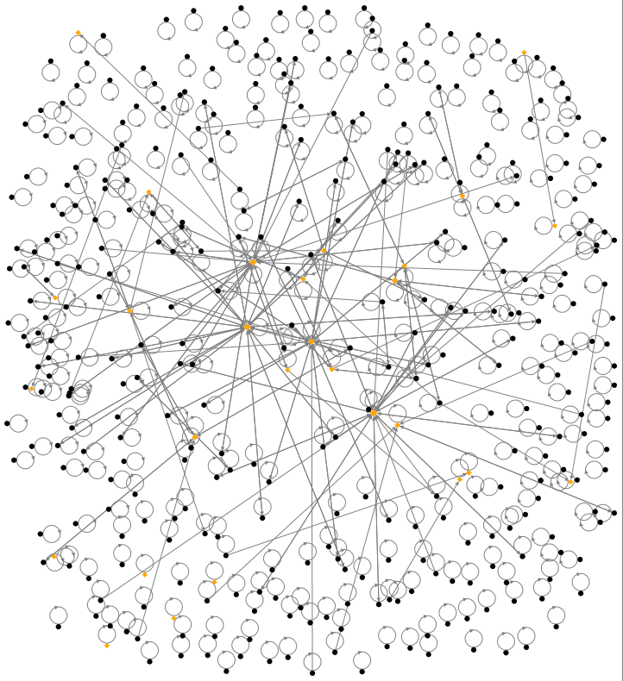
What Happens When we Remove the Top 5?

Slide 6
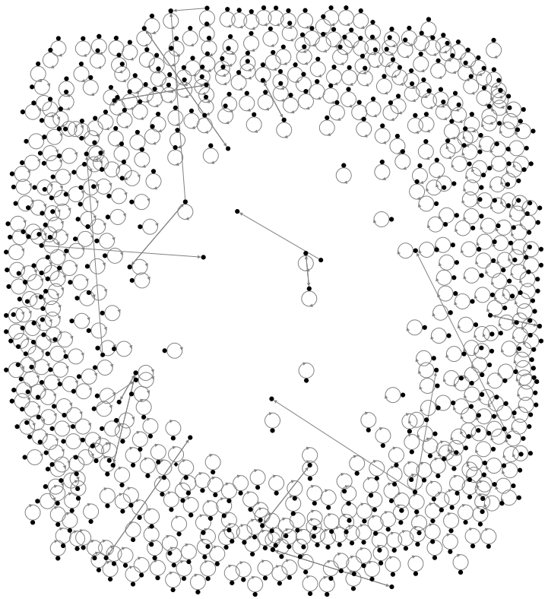
What Happens if we Remove all TI Employees?

Slide 7
From the Overall Network Perspective
Metrics | Members and TI Employees | Top 5 Missing | No TI Employees
Vertices | 1091 | 828 | 636
Edges | 2092 | 1130 | 654
Average Degree | 2.8 | 2.4 | 2.1
Average Betweeness | 1217.501 | 50.205 | 0.019
Density | 0.0012 | 0.00066 | 0.00008

Slide 8
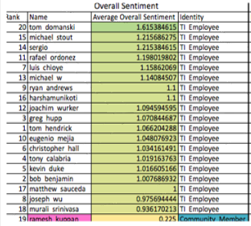
Sentiment Analysis

Slide 9
Implications
Customers are not helping customers!
Employee performance appraisal
Network – visualize the position and calculate the centrality of employees
Sentiment Analysis - identify which employees give the highest quality responses (e.g., John Doe)
Improving TI’s technical documents
Look at posts with negative sentiment scores
Find the posts of “isolated members”

Slide 10
Predicting Business Outcomes From User Generated Content
Can UGC (e.g., product reviews) predict business outcomes such as sales and market share?
Often users mention competing products in reviews
Can we extract preference information?
Can we draw product preference networks from this information?
Can such networks help predict business outcomes?
Slides based on Zhang et al. (2013)

Slide 11
From Product Comparisons to Preference Networks
“The B&W P7 are high on my favorite list after the H8 by B&O. I also like the new P5 because their sound is almost as good as the P7.”
“I just love the luxury, style and performance of the Audi A6; the Lexus GS300 is a nice reliable car and a very good value, but lacks the coolness factor.”
Sentiment score
= +4
Weight = 4-2 = 2
+2
+3
4-3 = 1
Audi A6
+4
Lexus GS300
“I need a super reliable car with the great creature comforts, and while the A6 is a wonderful car, it’s quite expensive; the Lexus GS300 isn’t exactly the lap of luxury, but really fits the bill for me in every way.”

Slide 12
The Main Idea
Product preference networks
Arrows indicate implicit preferences
Relative desirability of a node
A product review
Must mention two or more products
Has two sentiment scores (s₁ and s₂) for two products 1 and 2 respectively.
Arrow between the two product, tip ends on the product with higher sentiment score
Difference in sentiment scores becomes the weight of the arrow
How to put a score on each node which represents its desirability

Slide 13
What Metric Can Capture the Relative Importance of a Product?
Create a network of product preferences
PageRank is one possibility
Developed by Larry Page, Serge Brin & Rajiv Motwani at Stanford
A variation of the good old eigenvector algebra
Based on how many web pages refer to a particular web page.

Slide 14
Problems Galore …
Web page x₁
Links to:
Page x₃
Web page x₃
Links to:
None
Web page x₂
Links to:
Page x₃
What does the transition matrix look like?
What will be the PageRank scores? Will there be a problem?
Source: http://pi.math.cornell.edu/~mec/Winter2009/RalucaRemus/Lecture3/lecture3.html

Slide 15
Problem Cases (Contd.)
Web page x₁
Links to Page x₂
Web page x₃
Links to:
Pages x₄ & x₅
Web page x₅
Links to:
Pages x₃ & x₄
Web page x₂
Links to Page x₁
Web page x₄
Links to:
Page x₃ & x₅
What did Brin et al. suggest as a solution?
Source: R. Remus

Slide 16
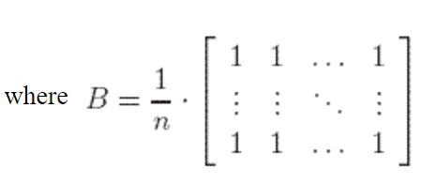
Brin et al.’s Solution
Replace the original transition matrix A by
M = (1-p). A + p.B
where 0 < p < 1 (often taken to be a small number, like .05 or .1)
What is the interpretation of this version of the transition matrix?
How does this help?
Source: R. Remus

Slide 17
Weighted PageRank
Not all incoming links are created equal
Different ways to create weights on links
networkx library in python can calculate weighted PageRank scores

Slide 18
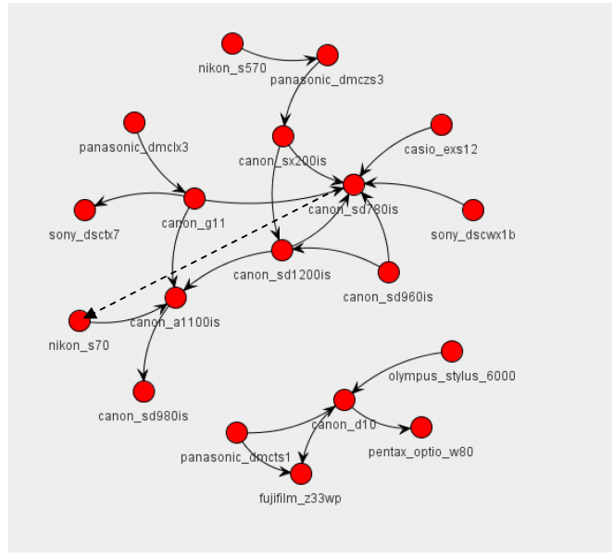
Real World Implications

